Slide 1
Assignment6

Slide 2
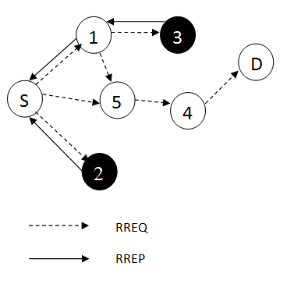
Black Hole Attack
Back Hole attack is kind of DoS attack in which a malicious node called black hole node present in the network pretend itself as having shortest and safe path to destination by sending false RREP to source, due to which source node start to send data packet through that path and after receiving data packet, malicious node drop them fully or partially.

Slide 3
Design a network according to the following parameters detail. Simulate the network to calculate the performance metrics: (a) Packet Delivery Ratio, (b) End to End Delay, & (c) Average Throughput.
Implement the Black Hole Attack in Ad hoc on Demand Distance Vector Routing Protocol (AODV).
After the Black Hole attack, calculate the performance metrics stated as previous with respect to the number of malicious node.
Implement a black hole detection or avoidance method. After the black hole attack resolution, compare the results with previous simulation results.

Slide 4
SL NO. | PARAMETERS | DETAILS
1 | Channel type | Wireless channel
2 | Transmission range | 250 m
3 | No. of nodes | 50
4 | Maximum connection | 20
5 | Simulation time | 150 Sec.
6 | Terrain area | 100×100 m²
7 | Mac Protocol | IEEE 802.11
8 | Routing type | AODV
7 | Traffic type | CBR
8 | Agent | UDP
9 | Antenna type | Omni directional
10 | Radio propagation | Two ray ground
12 | Packet size | 1000 bytes
13 | No. of Black hole node | 1,2,3

Slide 5
Message passing technology
Implement the message passing technique in the wireless network using the following steps.
1. Define the parameters of wireless network.
2. Create the trace file and nam file.
3. configure the node.
4. Provide initial (X,Y, for now Z=0) co-ordinates for nodes.
5. Define the connection between the nodes.
6. Define a user define array or list array, which stores the random generated value.
7. Define the "process_data" instance procedure is what will process received data if no application is attached to the agent.
In this case, we respond to messages of the form "ping(###)". We also print received messages to the trace file.

Slide 6
8. Note in the trace file that the packet was received.
9. Now, schedule some messages to be sent, using the UDP "send" procedure. The first argument is the length of the data and the second is the data itself. Note that you can lie about the length, as we do here. This allows you to send packets of whatever size you need in your simulation without actually generating a string of that length. Also, note that the length you specify must not be larger than the maximum UDP packet size (the default is 1000 bytes) if the send procedure is called without a second argument (e.g. "send 100") then a packet of the specified length (or multiple packets, if the number is too high) will be sent, but without any data. In that case, process_data will not be called at the receiver.
10. Tell nodes when the simulation ends, i.e. stop procedure.
11. write:$ ns <file_name .tcl>
11. Create a awk script for tracing the data from trace file. (awk -f <awk_script.awk> <trace_file.tr>)

